Slide 1
Term Representation
Some terms are more important to the meaning of a document than others. Term weights are recommended to describe a document rather than the frequency statistics from the inverted index file.
The most effective and widely used approach for calculating term weights is a term frequency-inverse document frequency (TF/IDF) weighting scheme. The terms that appear frequently within a document are likely to reflect the document’s meaning more strongly compared with terms that appear less often;

Slide 2
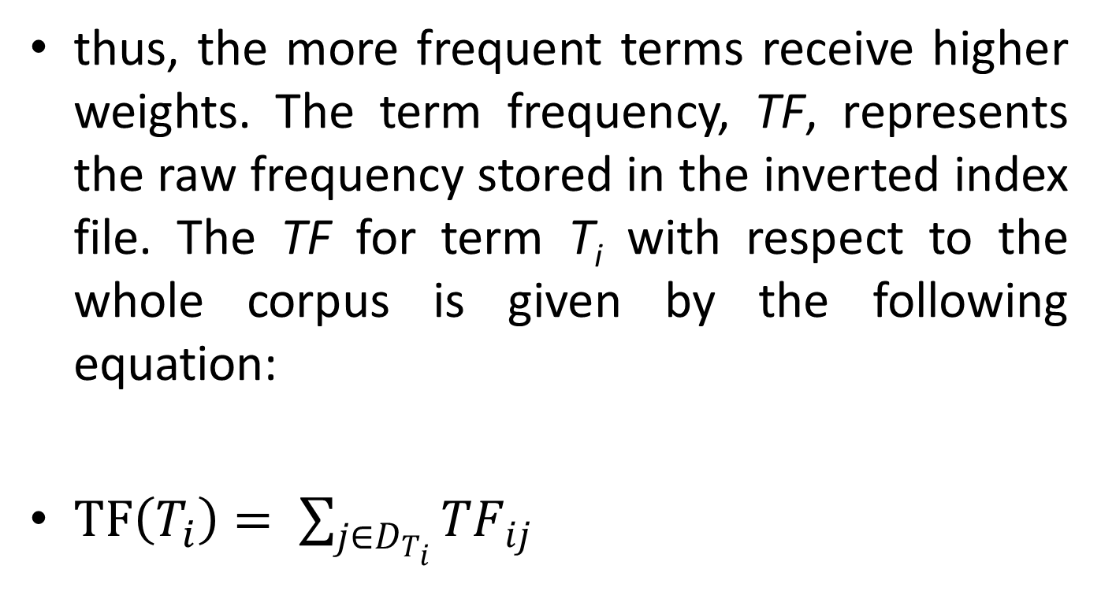
Term Representation
thus, the more frequent terms receive higher weights. The term frequency, TF, represents the raw frequency stored in the inverted index file. The TF for term T_{i} with respect to the whole corpus is given by the following equation:
$TF\left(T_{i}\right)= \sum_{j∈D_{T_{i}}}{{TF}_{ij}}$

Slide 3
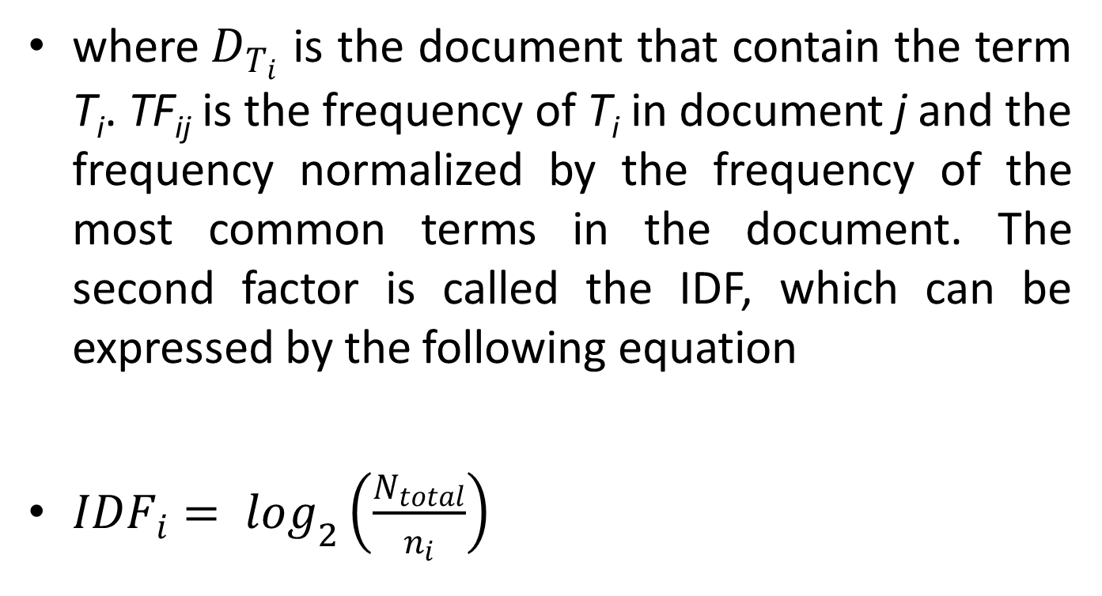
Term Representation
where$D_{T_{i}}$ is the document that contain the term T_{i}. TF_{ij} is the frequency of T_{i} in document j and the frequency normalized by the frequency of the most common terms in the document. The second factor is called the IDF, which can be expressed by the following equation
${IDF}_{i}= \log_{2}\left(\frac{N_{total}}{n_{i}}\right)$

Slide 4
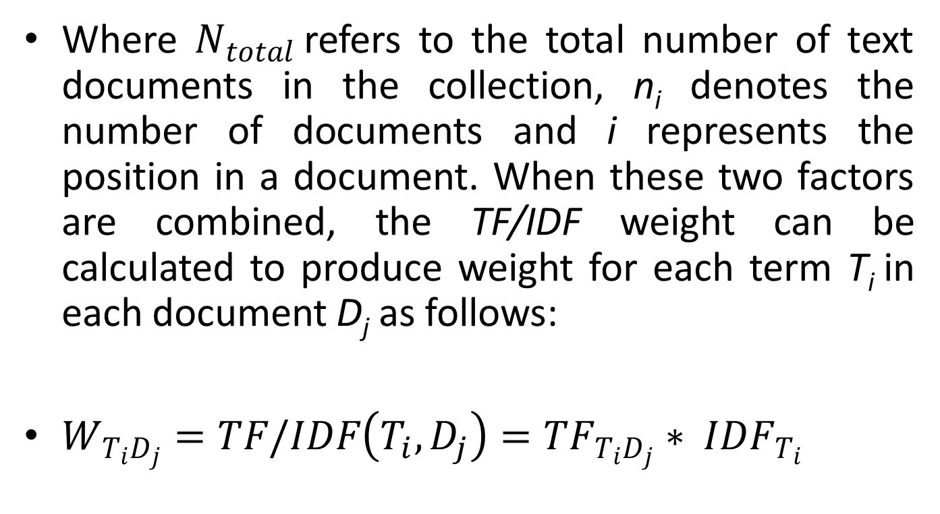
Term Representation
Where $N_{total}$refers to the total number of text documents in the collection, n_{i} denotes the number of documents and i represents the position in a document. When these two factors are combined, the TF/IDF weight can be calculated to produce weight for each term T_{i} in each document D_{j} as follows:
$W_{T_{i}D_{j}}=TF/IDF\left(T_{i},D_{j}\right)={TF}_{T_{i}D_{j}}∗ {IDF}_{T_{i}}$

Slide 5
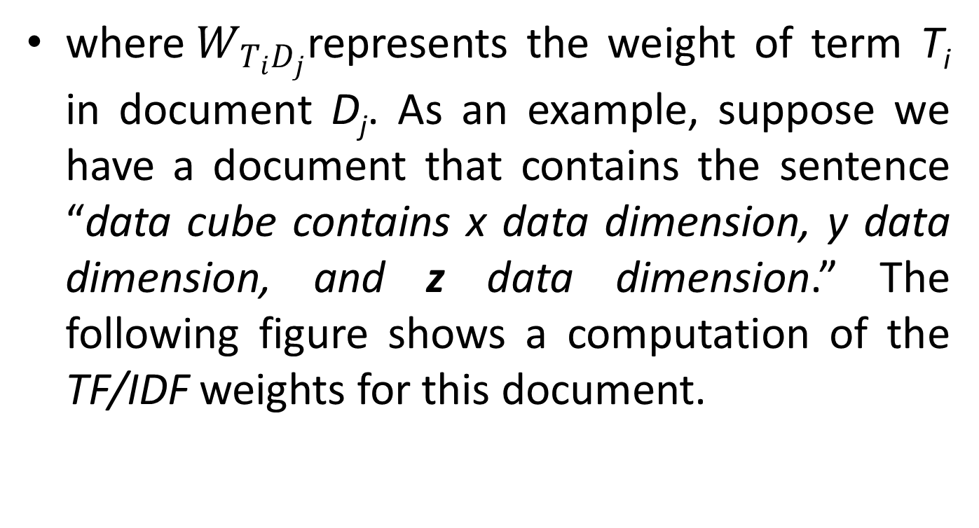
Term Representation
where$W_{T_{i}D_{j}}$represents the weight of term T_{i} in document D_{j}. As an example, suppose we have a document that contains the sentence “data cube contains x data dimension, y data dimension, and z data dimension.” The following figure shows a computation of the TF/IDF weights for this document.

